Slide 1
Methods for Blood Cell Counting
Dr. N.O.Ogidi

Slide 2
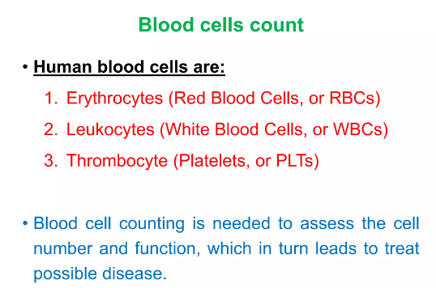

Slide 3
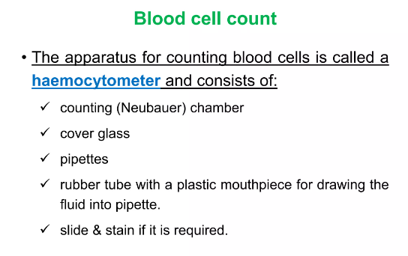

Slide 4
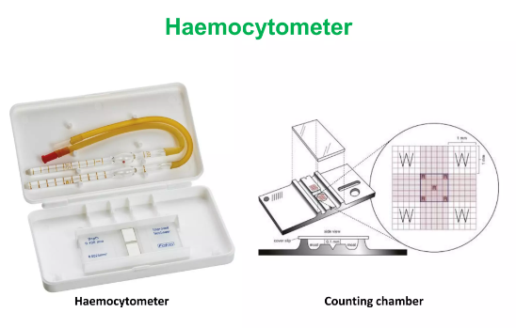

Slide 5
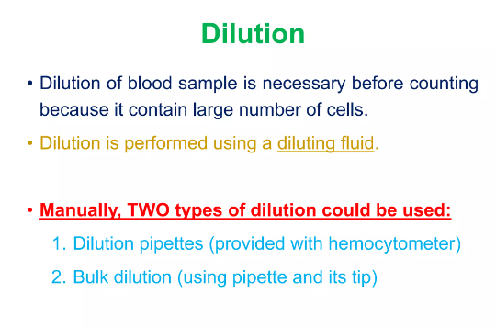

Slide 6
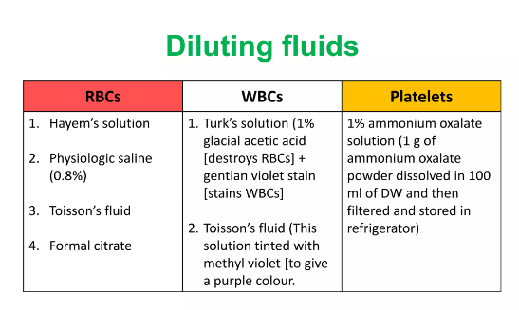

Slide 7

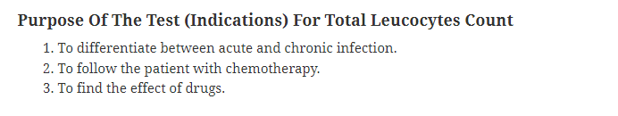
Total WBC Count

Slide 8
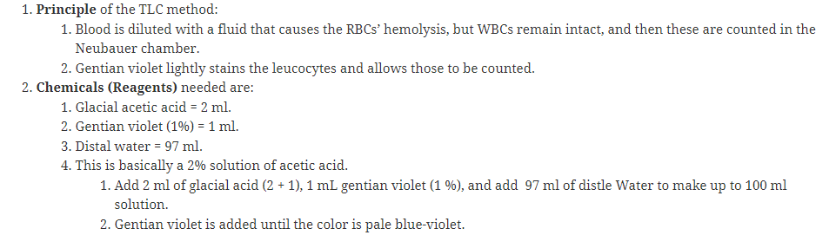
Total WBC Count

Slide 9
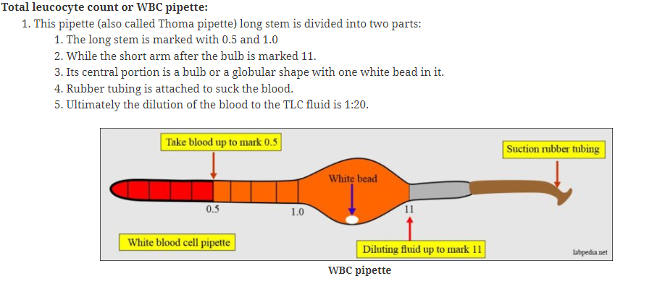
Total White cell Count using a WBC Pipette

Slide 10
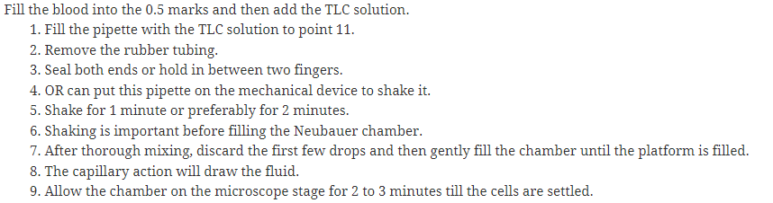
Procedure using a WBC Pipette

Slide 11
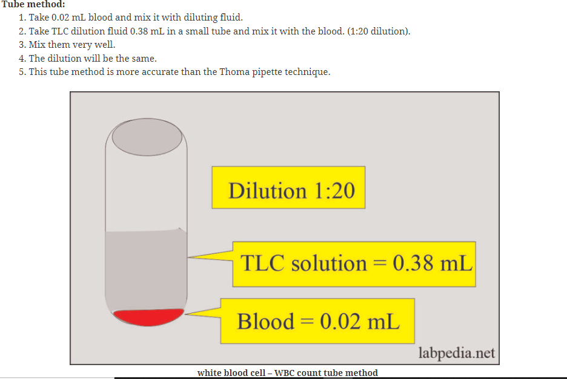
Total WBC Count Using Tube Method

Slide 12
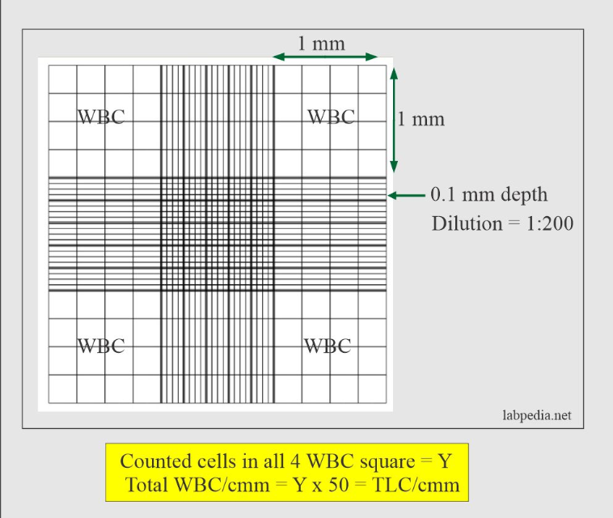

Slide 13
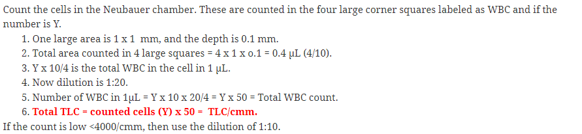
Total WBC Calculations

Slide 14
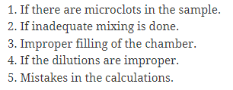
Sources of error for WBC counts

Slide 15

Normal Values for Total counts

Slide 16
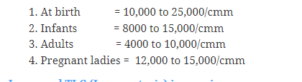

Slide 17
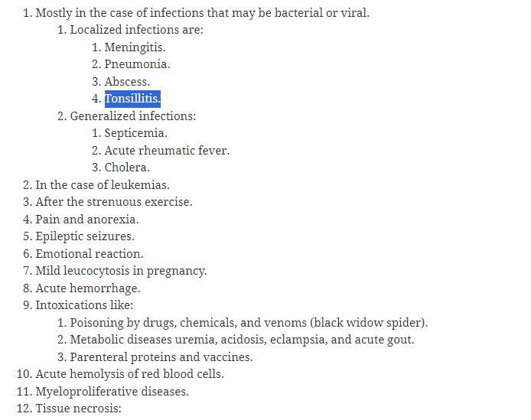
Increased WBC count (Leucocytosis)

Slide 18
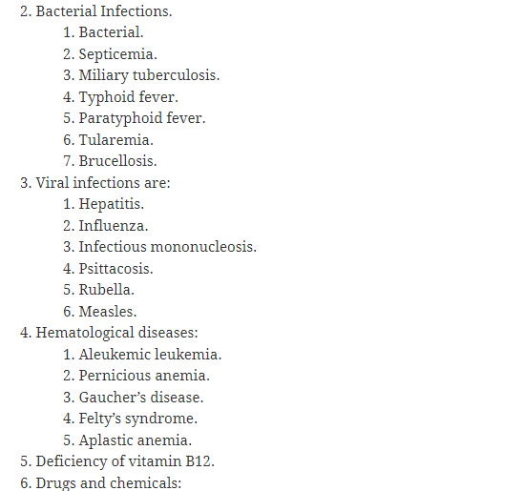
Decreased WBC Count (Leucopaenia)

Slide 19
RBC Count
The main purpose for performing a red cell count is to know if a patient
is suffering from erythrocytosis or polycythaemia ( i.e red cell count of ≥ 6.5 million/Mm³
Is suffering from erythropaenia (I.e decrease in red cell count to ≤ 3.5 million/Mm³

Slide 20
RBC Count
Blood is diluted in a 1:200 dilution using Haymen’s fluid, formal citrate or normal saline. Hayem’s fluid and formal citrate fix the cells and is isotonic to the cell. So it does not cause any damage. Normal saline is rarely used because it is associated with crenation of red cells and rouleaux formation

Slide 21
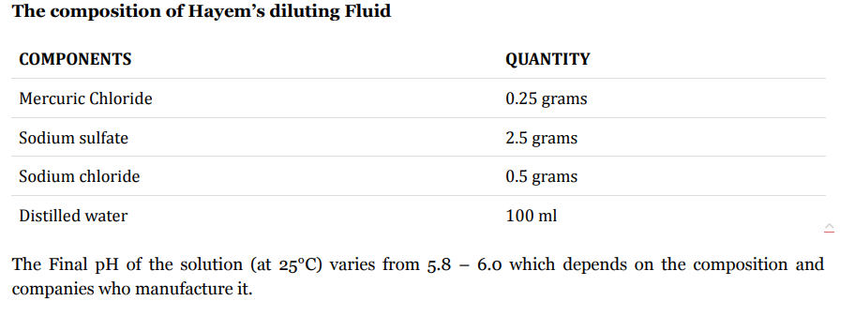
Hayem’s fluid

Slide 22
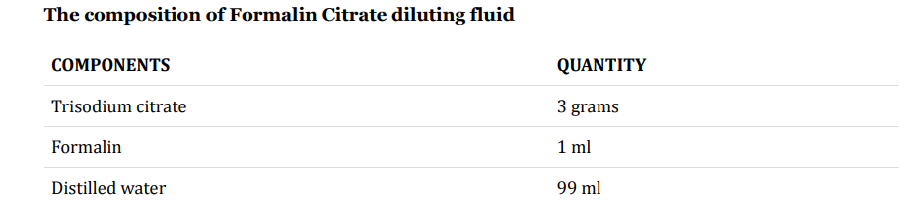
Formal Citrate

Slide 23
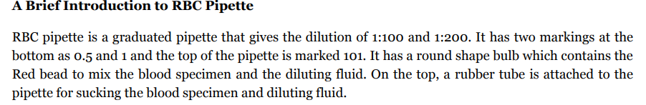
Microdilution Method for RBC Count
This involves the use of RBC Pipette for dilution

Slide 24
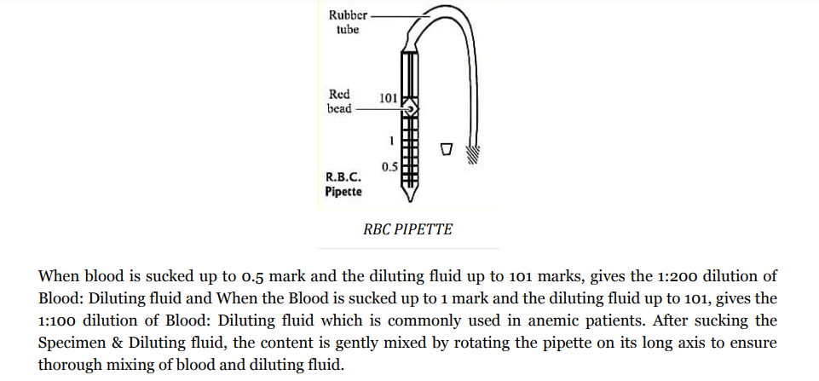

Slide 25
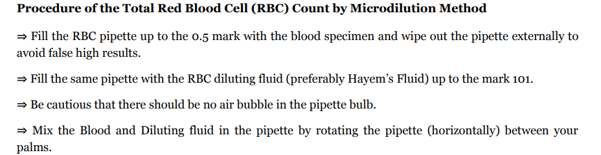
Microdilution method RBC Count

Slide 26
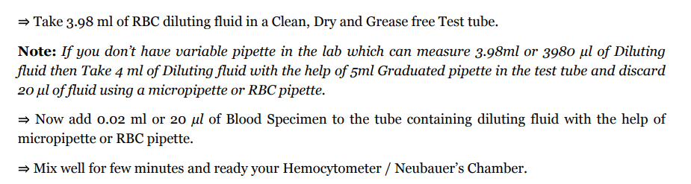
Macrodilution method for RBC Count

Slide 27
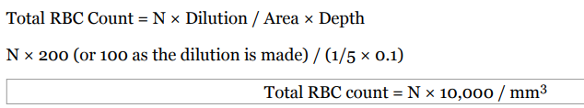
Calculation for Total RBC Count

Slide 28
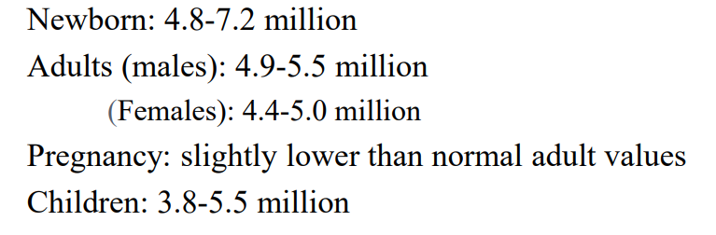
Normal Ranges of RBC

Slide 29
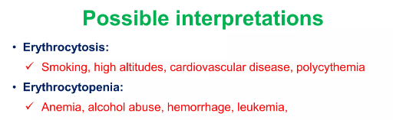

Slide 30
Platelet Count
The purpose of platelet count is to determine if a patient is suffering from thrombocytosis (Platelets more than 700,000/ Mm³)
Or Thrombocytopaenia (Platelets less than 50,000/ Mm³

Slide 31
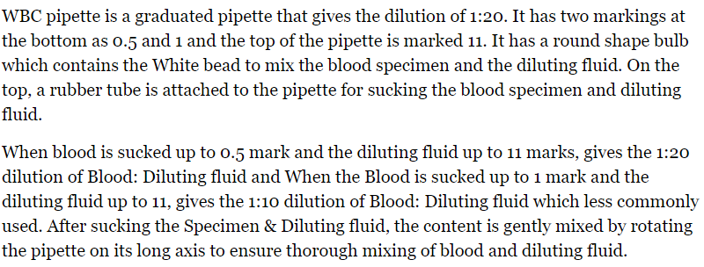
Microdilution method for platelet count
Pipette used for dilution

Slide 32
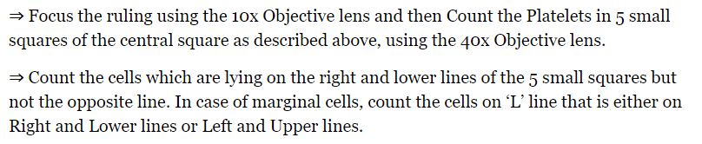
Counting Platelets under the microscope

Slide 33
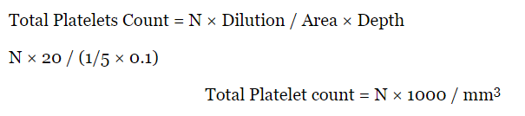
Calculation for Platelet Count

Slide 34

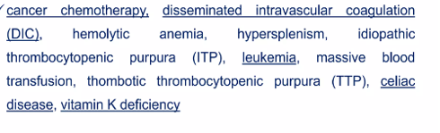
Clinical Application of Platelet Count
Thrombocytosis-
Thrombocytopaenia

Slide 35
Challenges of Manual counting
Poor reproducibility of results
Cumbersome process

Slide 36
Automated Counters
Principle
Automated systems are now based on flow-through (also called flow cytometry) optical technologies that identify cells on the basis of light scatter properties broadly equating to the cell’s physical characteristic differences.

Slide 37
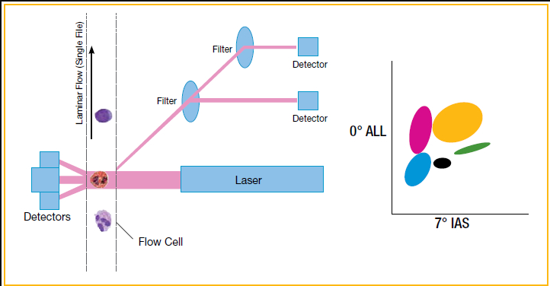

Slide 38
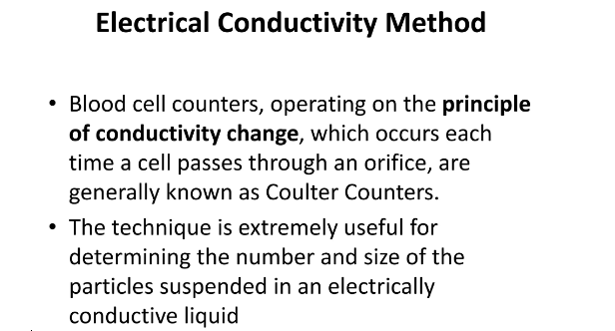
Automatic Counters

Slide 39


